Slide 1
Do Now
Partner Up
On Whiteboard:
What are the possible offspring of a father who is Type AB and mother who is type O?
Hint: Use a punnett square!
Can any offspring receive blood from the father? Support your answer with your understanding of A and B antigens and anti-A and anti-B antibodies

Slide 2
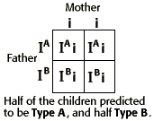
Answer
NONE of the offspring could receive blood from the father
If type A, will have anti-B antibodies that will attack
If type B, will have anti-A antibodies that will attack

Slide 3
RH Factor

Slide 4
RH comes from experiments done on the Rhesus Monkey
RH Factor is another way for scientists to categorize blood (blood types)
Possible phenotypes:
RH factor
Have it (RH positive; +)
Don’t have it (RH negative; -)

Slide 5
Antigen/Antibody
RH antigen
RH⁺ Means you have RH Antigen
RH⁻ Means you do not have RH Antigen
RH Antibodies
RH⁺ No antibodies (because they would recognize the RH factor on your blood cells and destroy them)
RH⁻ Make antibodies against RH antigen (cannot receive + blood if you are -)

Slide 6
How is RH Factor Inherited?
RH factor is inherited by a simple dominant and recessive relationship where:
R = RH positive (dominant)
r = RH negative (recessive)
Example:
What are the possible blood types (+ or -) of a father who is heterozygous for RH⁺ and a mother who is RH⁻ ?

Slide 7
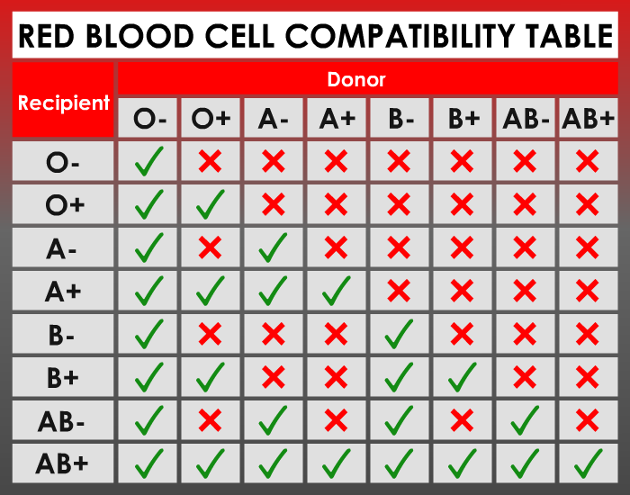
Updated Blood Donation Chart

Slide 8
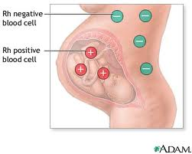
Hemolytic Disease

Slide 9
Solution?
Mother takes a shot of Rh immunoglobulin also known as RhoGAM
Prevents mom’s anti-Rh antibodies from “attacking” the Rh positive blood of the baby
Taken around the 28th week of pregnancy, then again after birth if the child is Rh (+)

