Slide 1
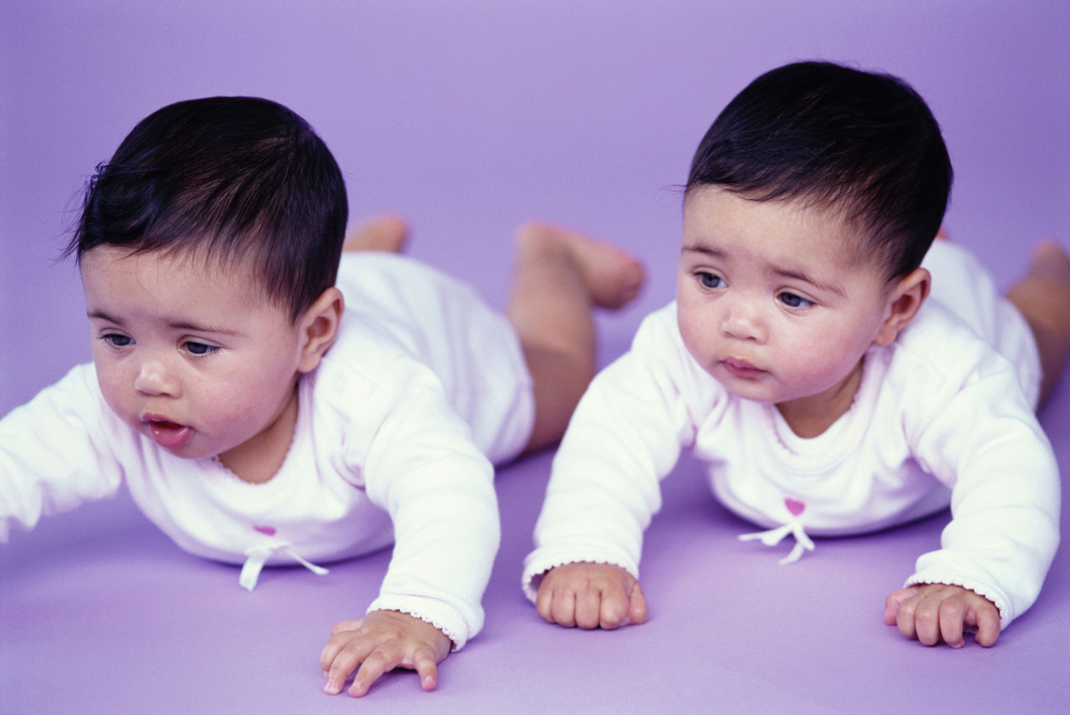
Twins

Slide 2
What are twins?
Two children born at the same time (mother goes into labor once)

Slide 3
Identical twins vs. Fraternal twins
Identical twins
One sperm (dad) fertilizes one egg (mom)
Fertilized egg splits and forms two babies that are genetically identical
Fraternal twins
Two sperm (dad) fertilizes two eggs (mom)
Each fertilized egg develops independently in the mom until birth (same as brothers or sisters, but born at the same time; can even be different genders)

Slide 4
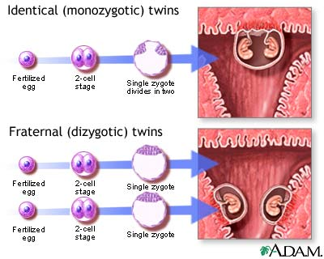

Slide 5
What are the chances of having twins?
Only 1-2% chance of having twins
Certain conditions may increase those chances
Ex. Medications (fertility drugs that increase the number of egg cells released each month)

Slide 6
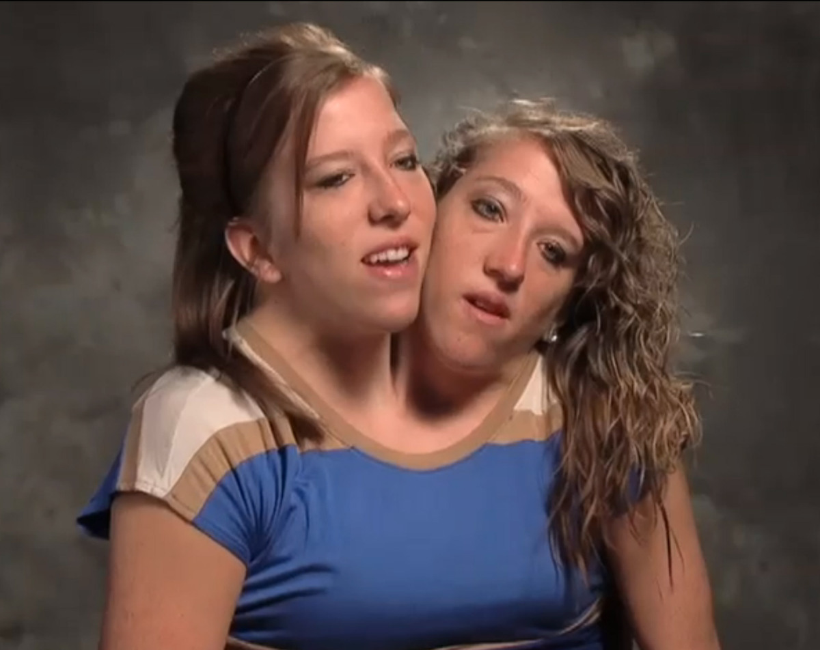
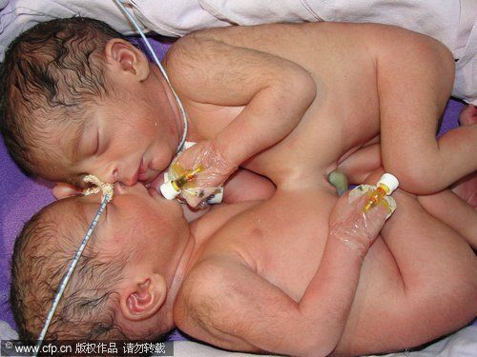
Special Cases
Conjoined (Siamese) twins
Formed when the fertilized egg (zygote) does not split completely for identical twins

