Slide 1
Blood Types Summary

Slide 2
American Red Cross Statistics

Slide 3
Antigens and Antibodies
Antigens
Carbohydrates (sugars) that signal antibodies
Illustrated with the colored shapes
Ex. Yellow triangle = A antigen, Blue Circle = B Antigen, Brown Square = Rh Antigen
Antibodies
Destroy foreign particles (ex. Anti-A antibody destroys cells that possess any A antigen (yellow triangle)
Your body will produce antibodies to destroy any foreign particles, but will not produces antibodies to destroy antigens you normally have
Ex. Type A blood types have type A antigens
The body will produce anti-B antibodies but will not produce anti-A antibodies

Slide 4
Genetics of Blood Type- ABO System
I^{A} I^{B} and i are the three possible copies of genes (alleles)
I^{A} allele will give A antigen (anti-B antibodies)
I^{B} allele will give B antigen (anti-A antibodies)
i allele will give no antigens (anti-A and anti-B antibodies)

Slide 5
Phenotypes ABO System
I^{A}I^{A}- type A (homozygous for A antigen)
I^{A}i – type A (A antigen and no B antigen)
I^{B}I^{B}- type B (homozygous for B antigen)
I^{B}i- type B (B antigen and no A antigen)
I^{A}I^{B}- type AB (A antigen and B antigen)
Codominance
Both A and B antigens are expressed (neither is “dominant”; both are “strong”)
ii- type o (No antigens at all)

Slide 6
Rh Factor
RH comes from experiments done on the Rhesus Monkey
RH Factor is another way for scientists to categorize blood (blood types)
Possible phenotypes:
RH factor
Have it (RH positive; +)
Don’t have it (RH negative; -)

Slide 7
Antigen/Antibody
RH antigen
RH⁺ Means you have RH Antigen (brown square)
RH⁻ Means you do not have RH Antigen
RH Antibodies
RH⁺ No antibodies (because they would recognize the RH factor on your blood cells and destroy them)
RH⁻ Make antibodies against RH antigen (cannot receive + blood if you are -)

Slide 8
How is RH Factor Inherited?
RH factor is inherited by a simple dominant and recessive relationship where:
R = RH positive (dominant)
r = RH negative (recessive)
Therefore RR or Rr gives Rh+ blood (has Rh antigen) and rr gives Rh- blood (no antigen)

Slide 9
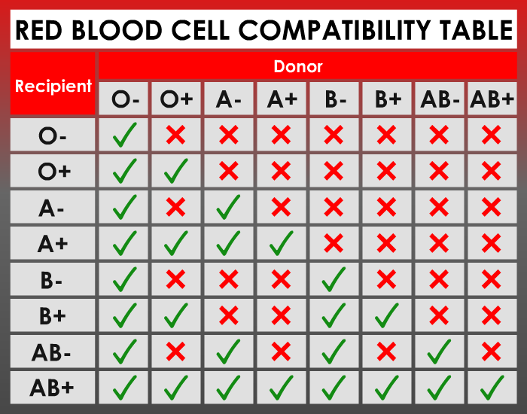
Updated Blood Donation Chart

Slide 10
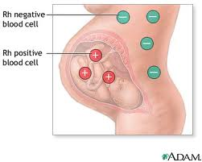
Hemolytic Disease

Slide 11
Solution?
Mother takes a shot of Rh immunoglobulin also known as RhoGAM
Prevents mom’s anti-Rh antibodies from “attacking” the Rh positive blood of the baby
Taken around the 28th week of pregnancy, then again after birth if the child is Rh (+)

