Slide 1
Incomplete Dominance and Codominance

Slide 2
Incomplete Dominance
Sometimes when doing genetics problems, one gene is not completely dominant over another
Instead, there are three possible phenotypes, each correlating to a different genotype
Incomplete dominance means the traits will mix
Ex. RR = Red flowers, rr= white flowers
Instead of Rr = Red flowers, we get a mix (pink)

Slide 3
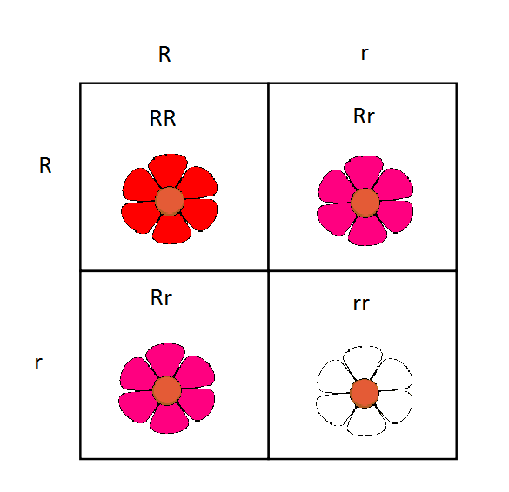

Slide 4
Do Now
If red is incompletely dominant over white flowers, what are the chances that two hybrid flowers will have a pink flower offspring?

Slide 5
Codominance
Sometimes when doing genetics problems, one gene is not completely dominant over another
Instead, there are three possible phenotypes, each correlating to a different genotype
Codominance means the traits will both be expressed
Ex. BB = Black bear, bb = white bear
Instead of Bb = black bear, both black and white show (panda)

Slide 6
