Slide 1
Cell Analogy Project
Detailed Instructions

Slide 2
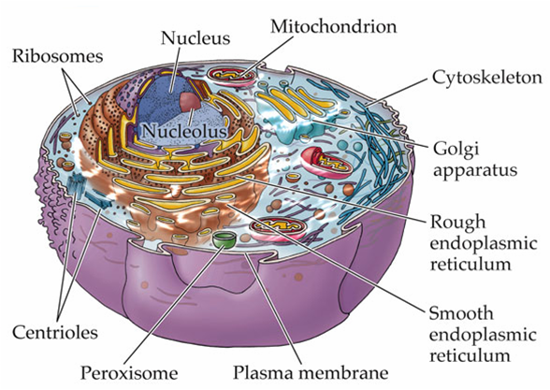
Cell Organelles
What machinery is in a cell?

Slide 3
Task 1
Complete the Cell Analogy Worksheet (page 1-2)
First, go through your notes and write down the function (job; what does it do for the cell) of each organelle (column 2)
Then, think of that function (job) and think about what part in a city would perform that same function, but for a city (column 3)
Have Mr. Tran check your work if you are unsure!
Lastly, explain your selection (column 4)
Ex. The wall around our city protects the city like the cell wall protects the cell
Get approval from Mr. Tran to begin rough draft

Slide 4
Task 2
Create a rough draft of your poster
On page 3 of handout
Be sure to include every “part in city” you wrote in column 3 of your outline
Label each part of your city with both the part in city name (ex. Brick Wall) and the cell organelle it represents (ex. Cell wall)
One per group
Get approval from Mr. Tran

Slide 5
Task 3
Create your final draft of your poster
Be neat! Refer to your rubric to see how you will be graded. Mess up final draft = buy your own poster board!
Every member of the group is responsible for presenting on Wednesday. Points will be deducted for unequal participation (you will explain why you drew each part in the city based on what the organelle does for a cell)
Be prepared for Mr. Tran to ask you questions about your poster!

Slide 6
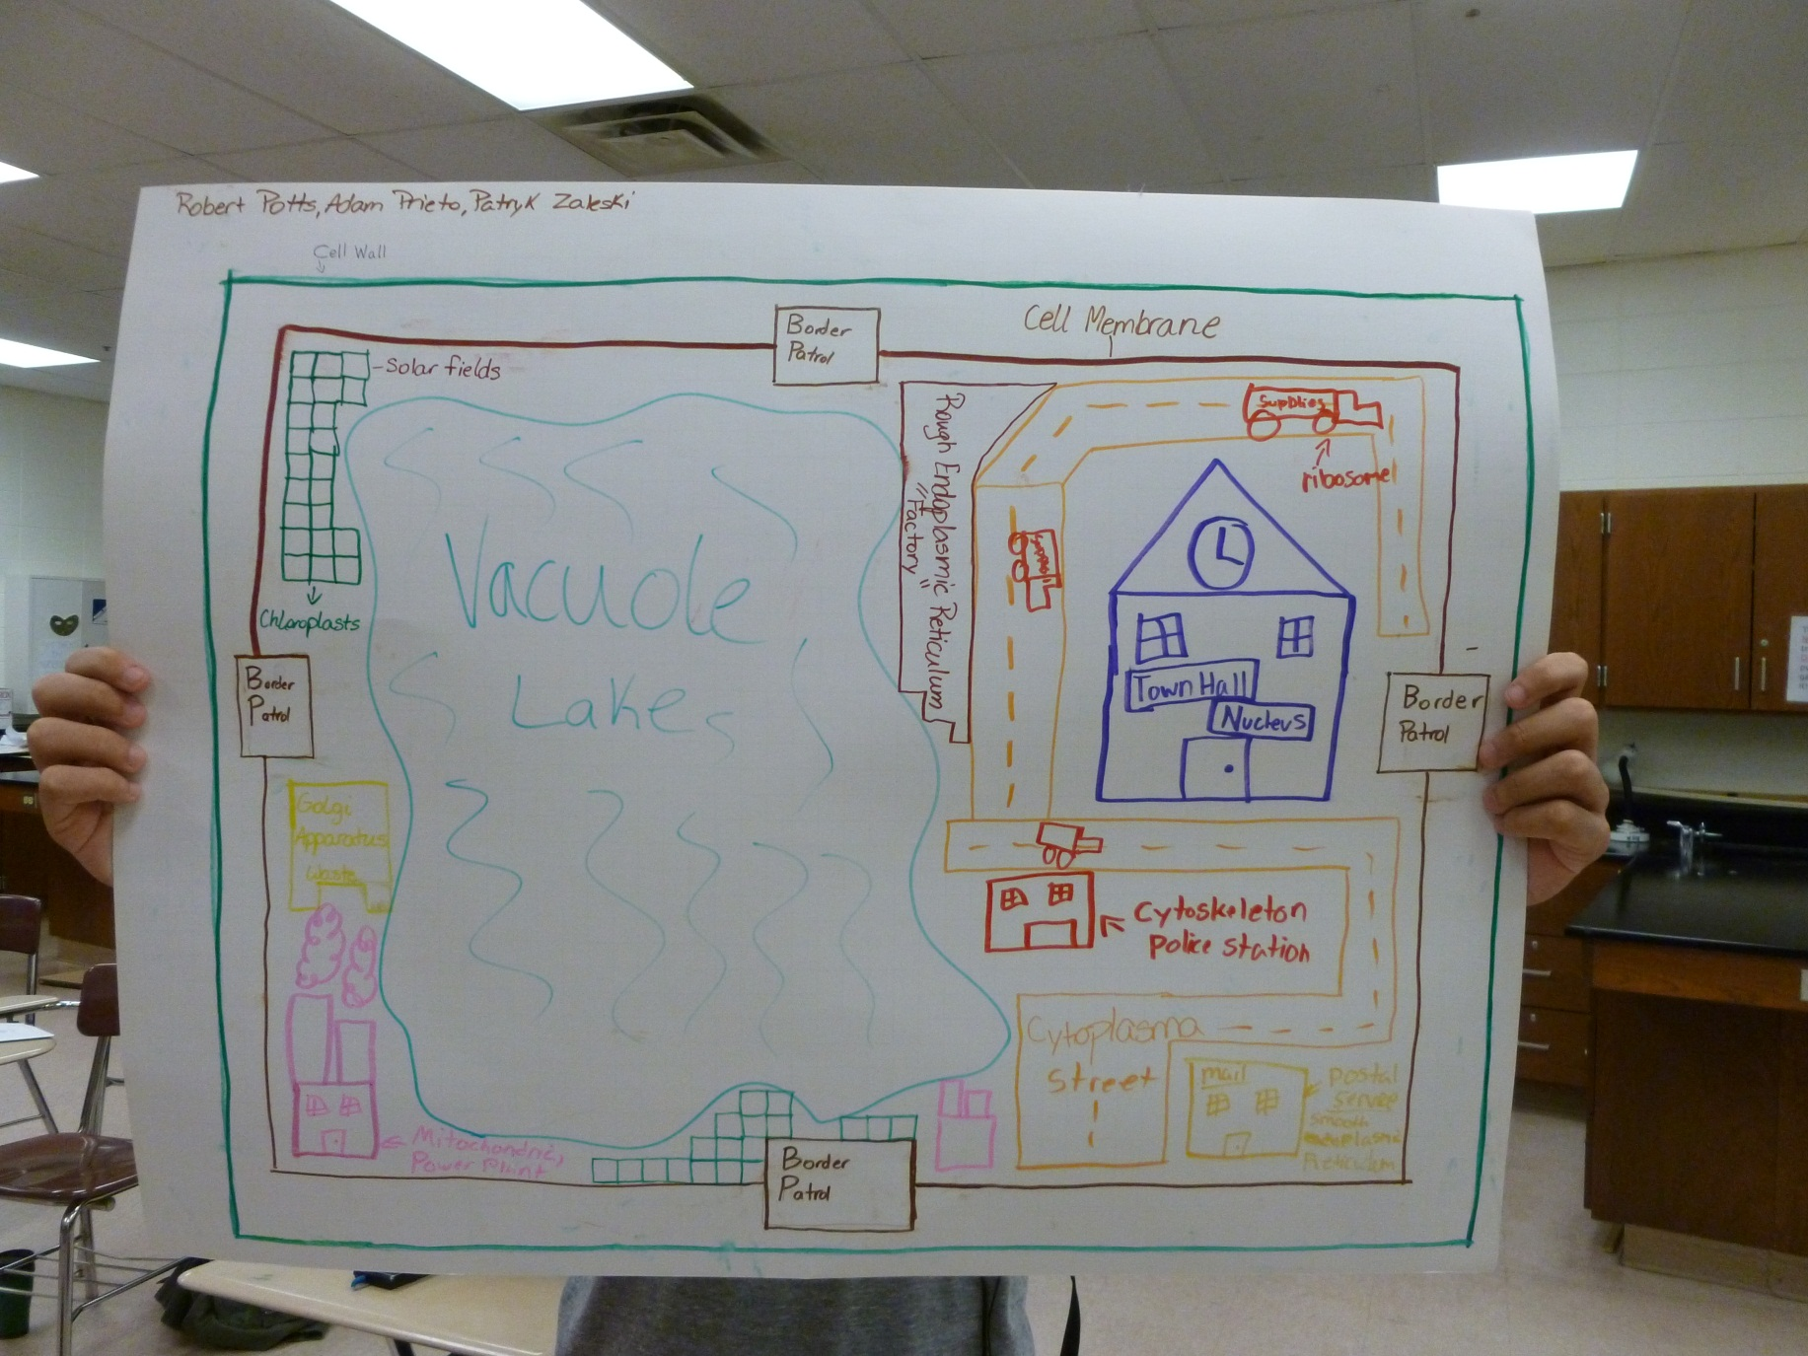
Example

Slide 7
Homework
Complete the cell analogy project worksheet
Every student will complete this INDIVIDUALLY
When we meet on Monday to begin the rough and final drafts of the poster, your worksheet should be DONE!

