Slide 1
Cell Respiration Virtual Lab

Slide 2
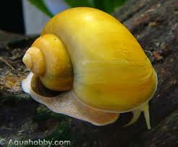
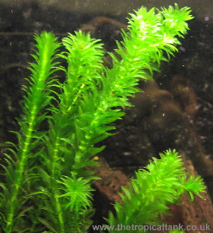
ANY CONSUMER
CO₂
O₂
+
+
H₂O
C₆H₁₂O₆
ANY PRODUCER

Slide 3
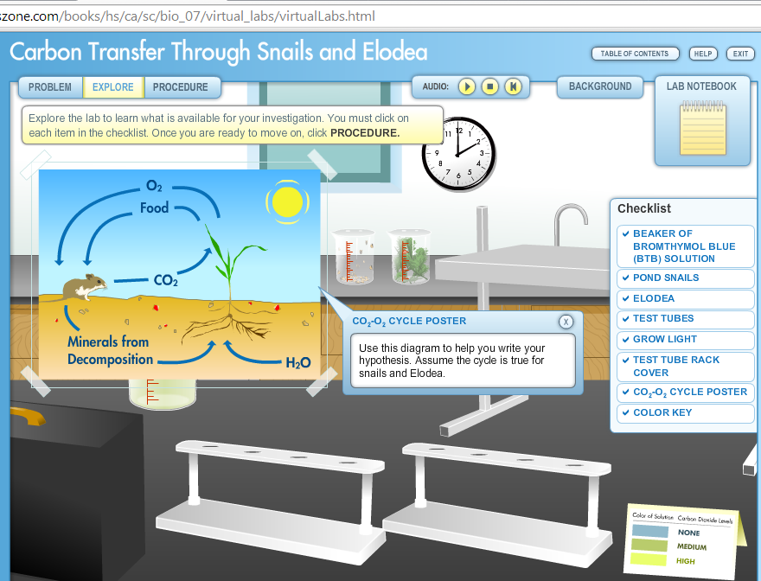

Slide 4
Virtual Lab
Snails = consumers
Cell respiration
Take in oxygen and glucose
Give off carbon dioxide and water
Elodea = producers
Photosynthesis
Take in carbon dioxide and water
Give off oxygen and glucose

Slide 5
How does carbon dioxide cycle in an aquarium?
Where does it come from?
How is it “recycled”?
How did we measure the level of carbon dioxide?
Bromothymol blue
Blue indicates…
Green indicates…
Yellow indicates…

Slide 6
What was the independent variable?
Independent variable = what the scientist can change/adjust/manipulate
What did we change for each test tube?
What was the control group?
Control group = a standard that you can compare your results against to look for any patterns/interesting findings
Which test tubes would we expect no change?

Slide 7
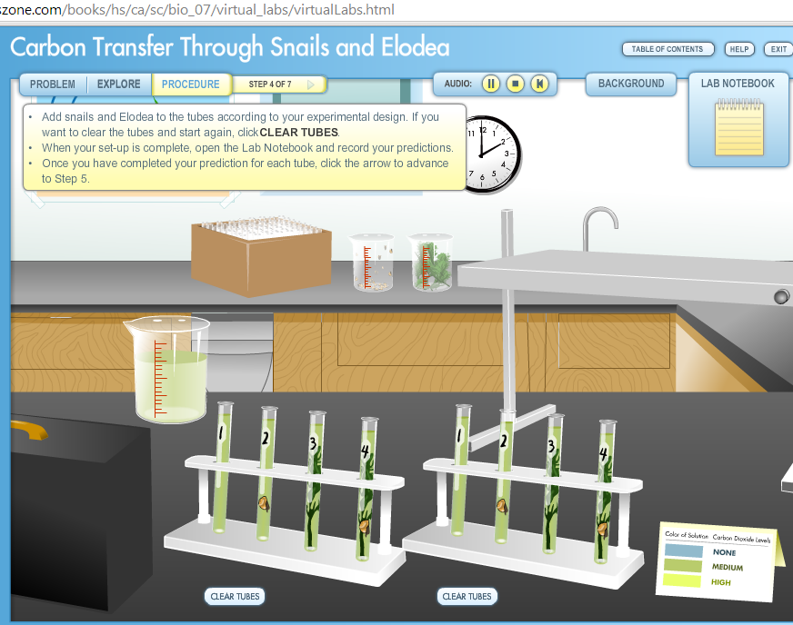

Slide 8
Results
Share the results of your experiment with your table
Were your predictions similar to the end results?
Explain your reasoning behind your predictions and why those predictions may have been incorrect

Slide 9
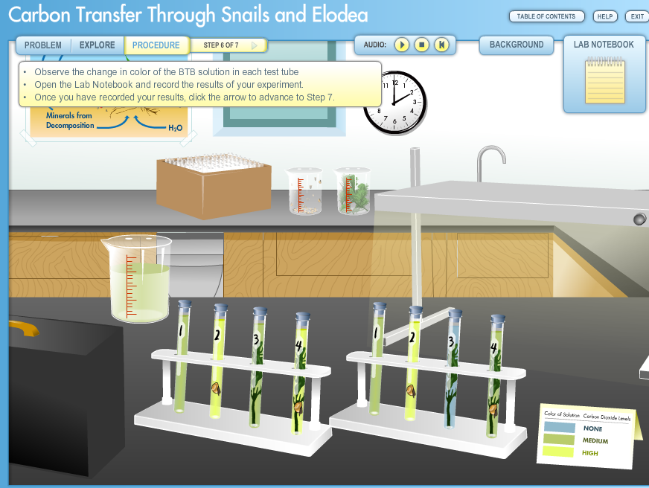
WHY!!!!?
Yellow
Yellow
Green
Yellow
5
6
7
8
Green
Green
Green
Blue

Slide 10
Results
Light tubes (tubes 1-4)
No snails, no elodea
No cell respiration, no photosynthesis
1 snail, no elodea
Cell respiration only, no photosynthesis
No snails, 1 elodea
No cell respiration, photosynthesis only
1 snail, 1 elodea
Cell respiration and photosynthesis (what is the result?)

Slide 11
Results
Dark tubes (tubes 5-8)
No snails, no elodea
No cell respiration, no photosynthesis
1 snail, no elodea
Cell respiration only, no photosynthesis
No snails, 1 elodea
No cell respiration, no photosynthesis
1 snail, 1 elodea
Cell respiration only, no photosynthesis (why?)

Slide 12
Conclusion
What is the relationship between snails and elodea
Same as the relationship between ANY consumer and producer!
Why did the color of BTB change?
Indicator of pH
Carbon dioxide + water = carbonic ACID (lowers pH and changes the color of BTB)
Why add elodea to a snail aquarium to have a healthy ecosystem?
Think back to our discussion of all consumers and producers

