Slide 1
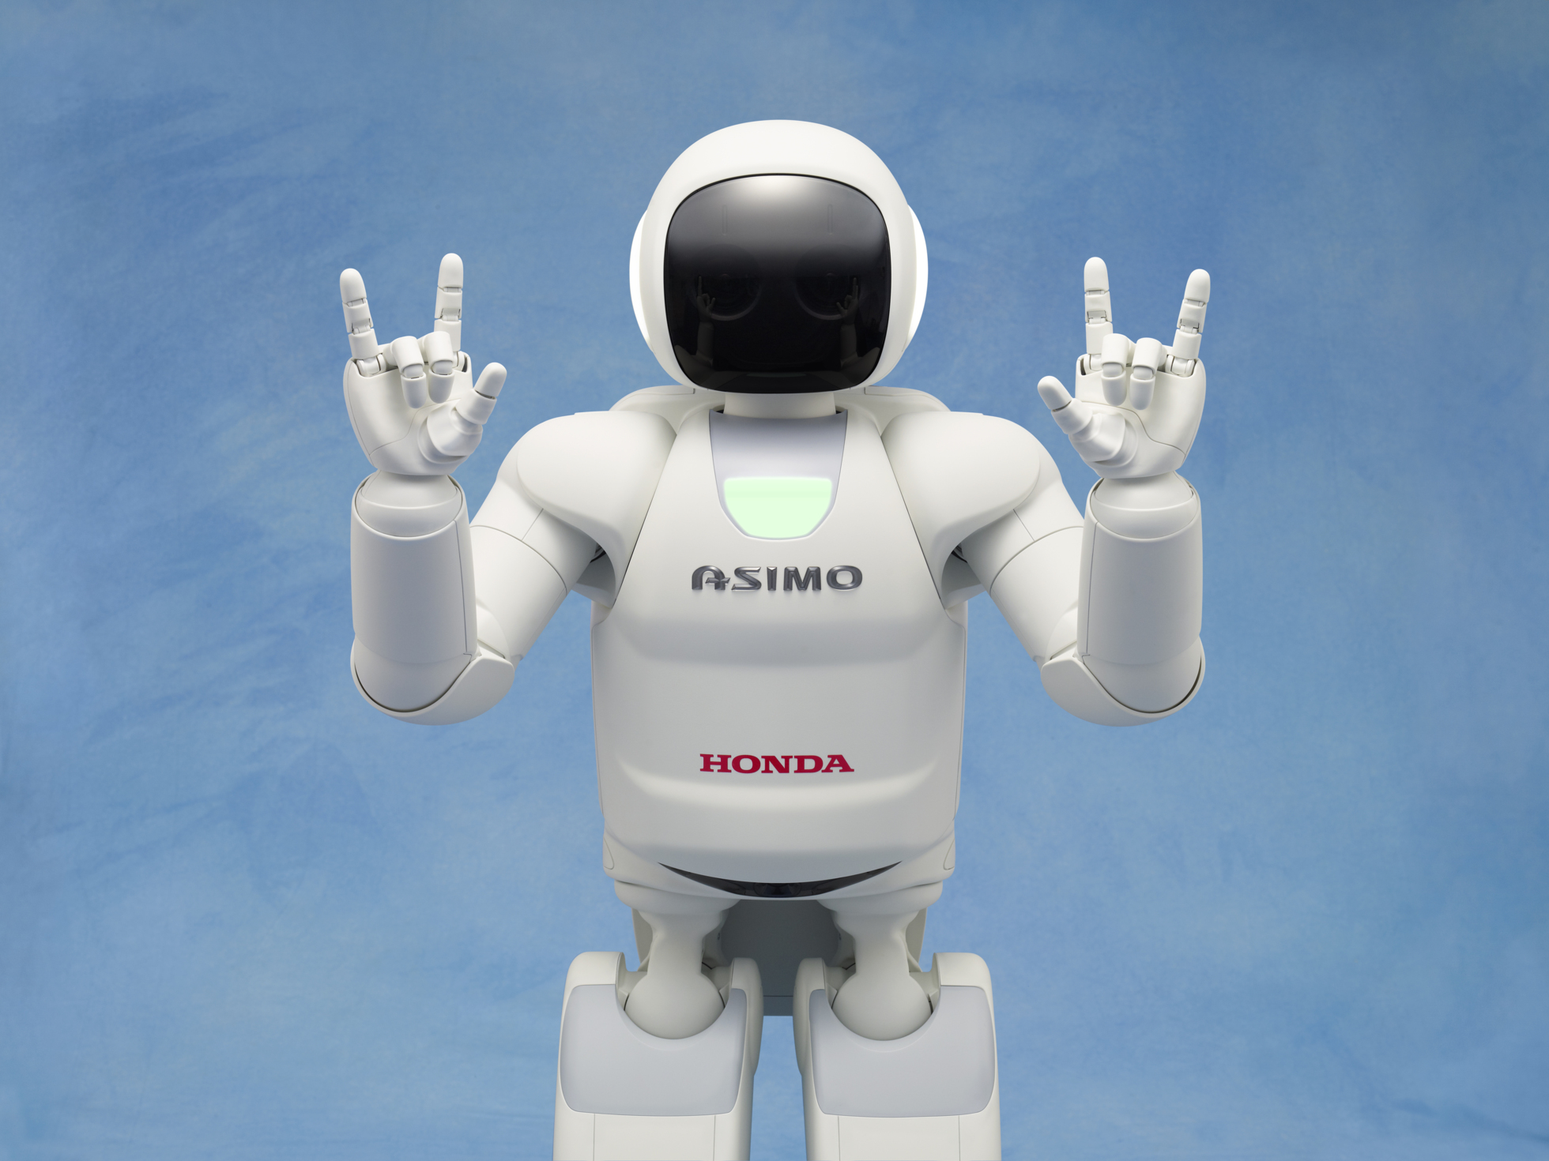
ASIMO
Robot created by HONDA (cars)
ASIMO = Advanced Step in Innovative Mobility

Slide 2
First, a video!
http://www.youtube.com/watch?v=juxLuo-sH6M

Slide 3
Characteristics of Life
Made of 1 or more cells
Displays organization
Grows and develops
Reproduces
Responds to stimuli
Requires Energy
Maintains homeostasis
Adapts/Evolves
An organism is anything that has or once had all of these characteristics

Slide 4
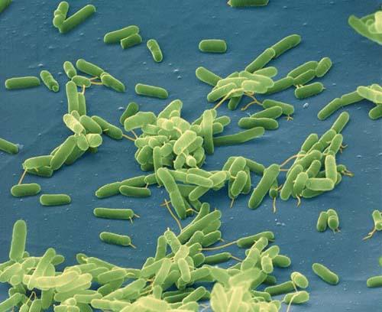
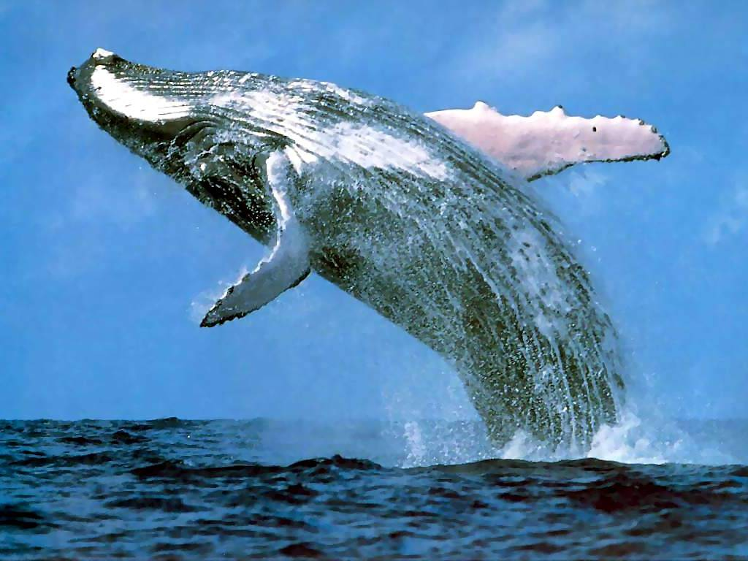
1. Made of one or more cells
Bacteria are unicellular meaning they are made of only one cell
The blue whale is multicellular meaning it is made of many cells

Slide 5
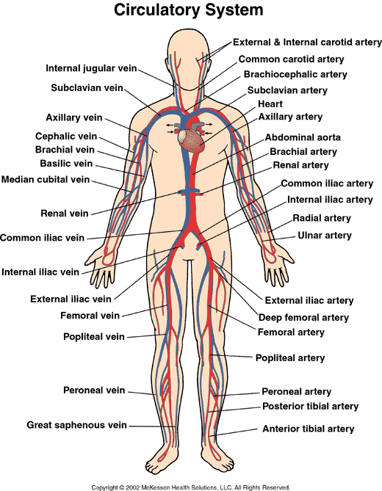
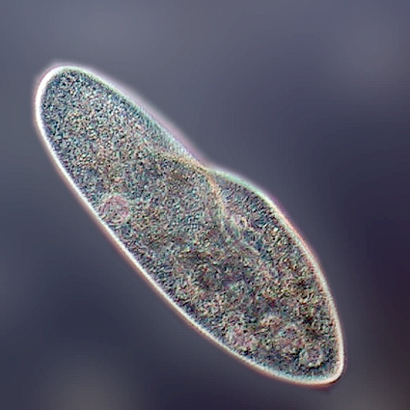
2. Displays Organization
Simple organization can be found within a single cell
Complex organization can be found in organ systems

Slide 6
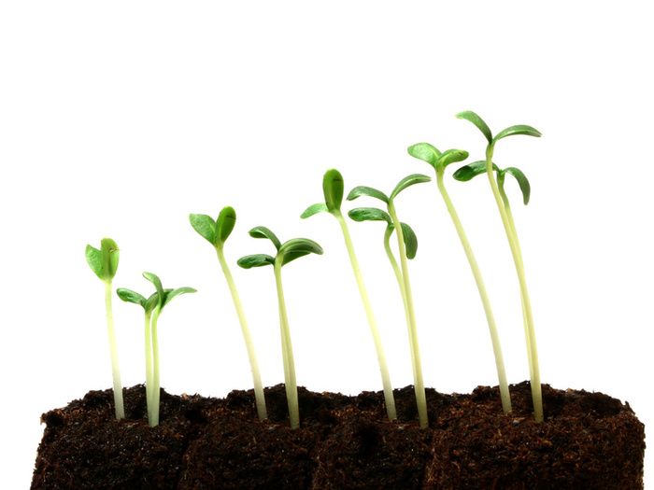
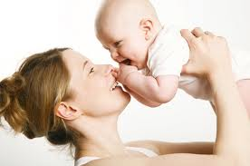
3. Grows and Develops
Growth is an increase in mass or weight
Development is a change in abilities

Slide 7
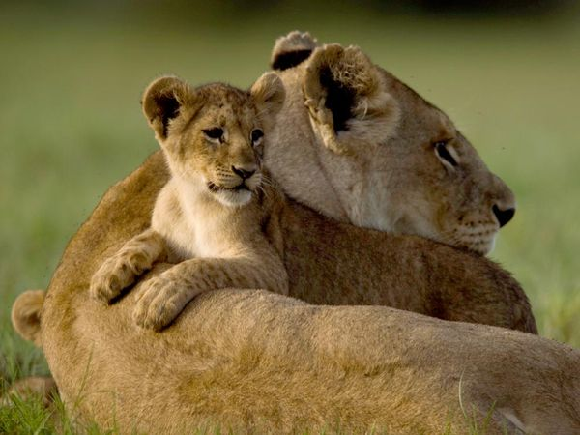
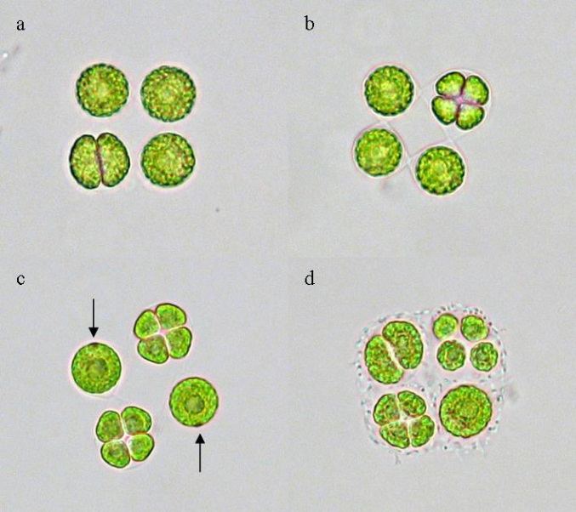
4. Reproduces
Production of offspring (next generation)
Sexual reproduction is when genetic information is exchanged
Asexual reproduction is when the same genetic information is used to make a copy

Slide 8
5. Responds to Stimuli
A stimulus is a “cause” whereas a response is an “effect”
The internal environment is what is inside of an organism
The external environment is what is outside of an organism

Slide 9
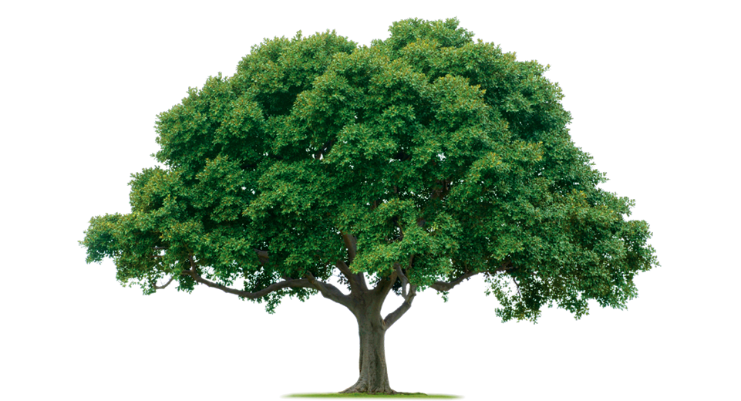
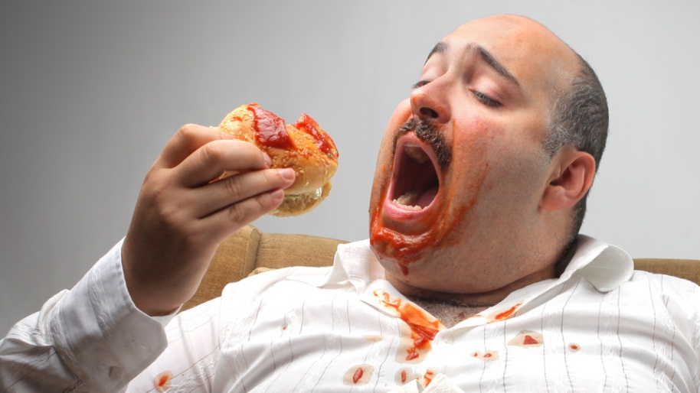
6. Requires Energy
All living things need food in one form or another
A producer makes it own food
A consumer needs to eat to survive

Slide 10
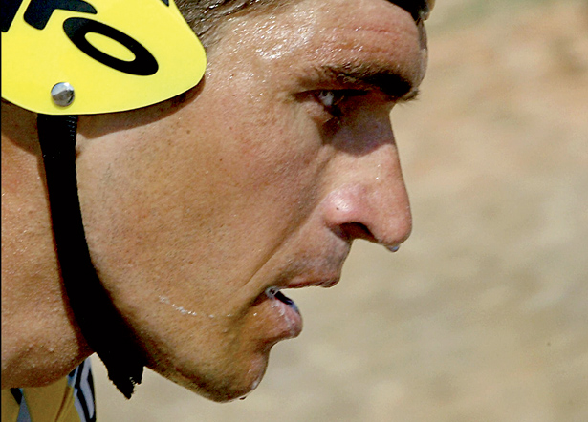
7. Maintains Homeostasis
Homeostasis means maintaining its internal environment
An example of homeostasis is when you are too hot, you sweat

Slide 11
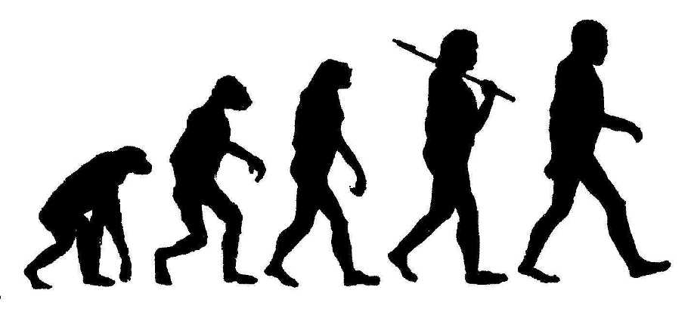
8. Adapts/Evolves
Adaptation and evolution does not happen within one generation or lifespan
An adaptation is any inherited (through genes) characteristic that results from changes to a species over time

