Slide 1
Photosynthesis Vocabulary

Slide 2
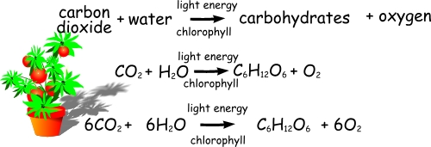
What is the equation for photosynthesis?
What are the reactants?
What are the products?

Slide 3
What is the light spectrum?
Sunlight is not one solid “color”
Sunlight is made up of many colors or “wavelengths” of light
The range of colors the human eye can see is known as the “visible light spectrum”
All colors between ultraviolet and infrared

Slide 4
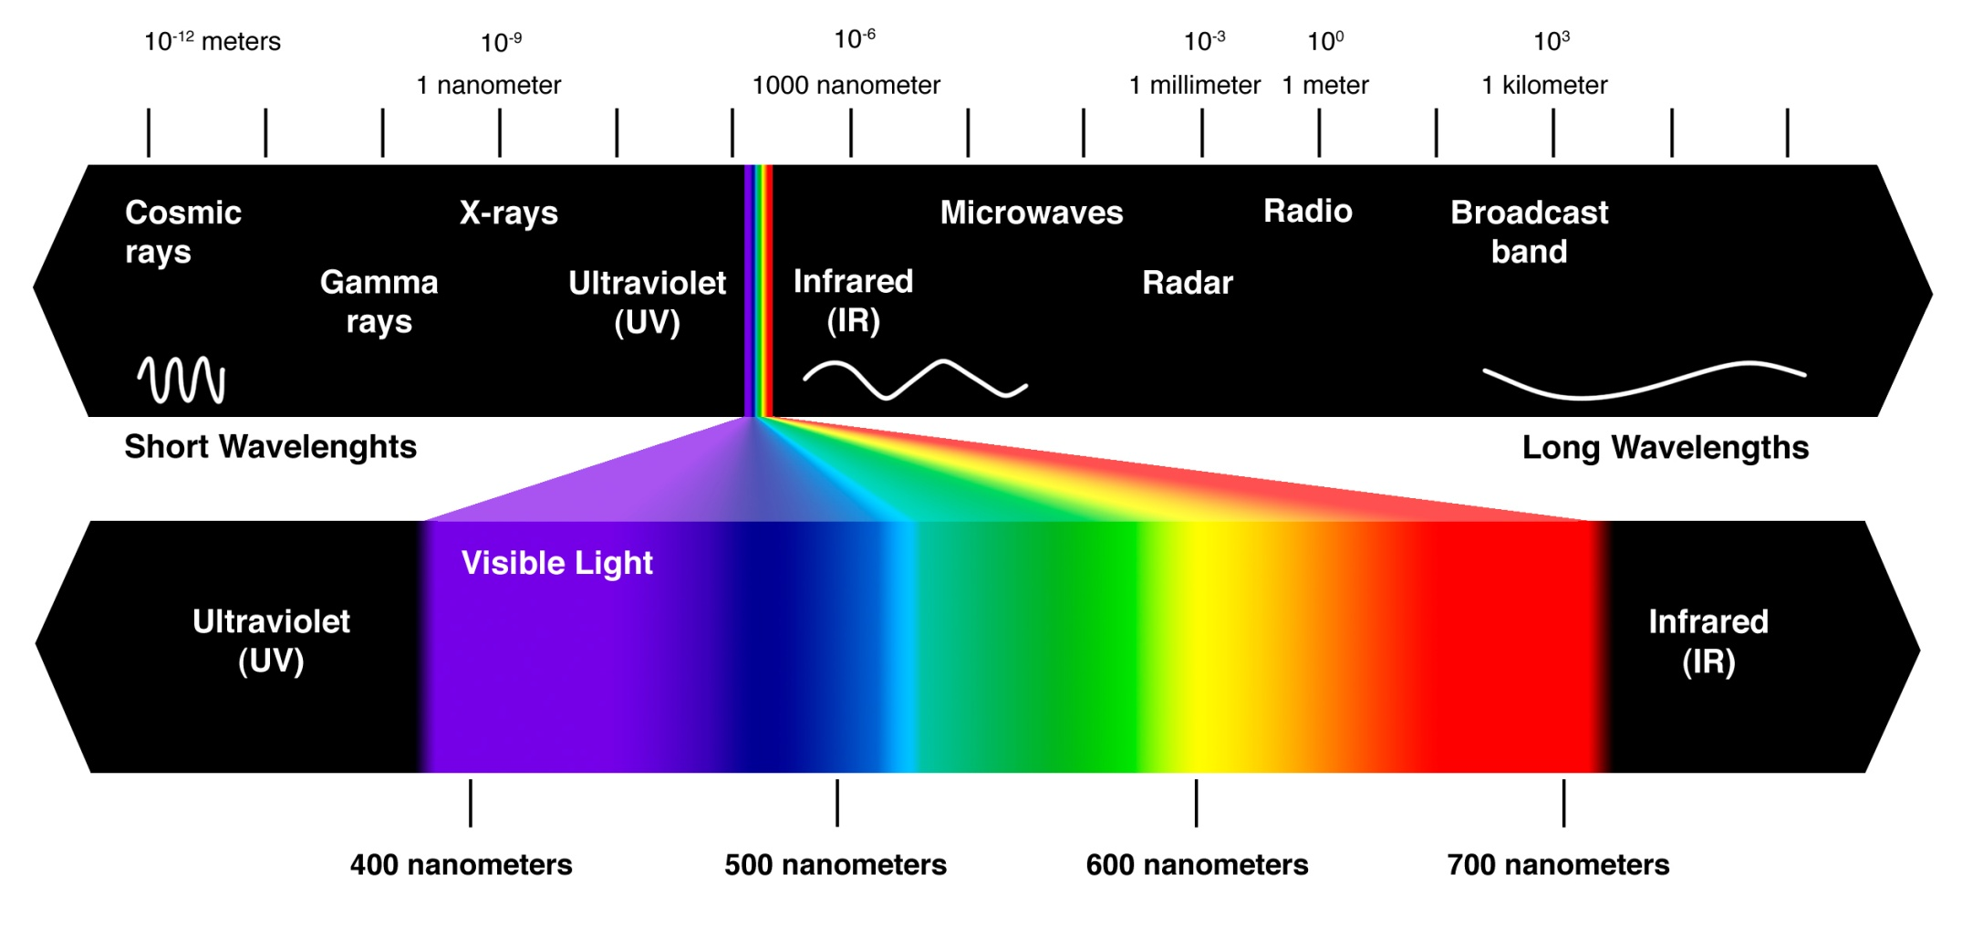
“white” light = all colors of light combined
“black” = the absence of light (it’s not a color at all but don’t tell Mrs. Coleman!)

Slide 5
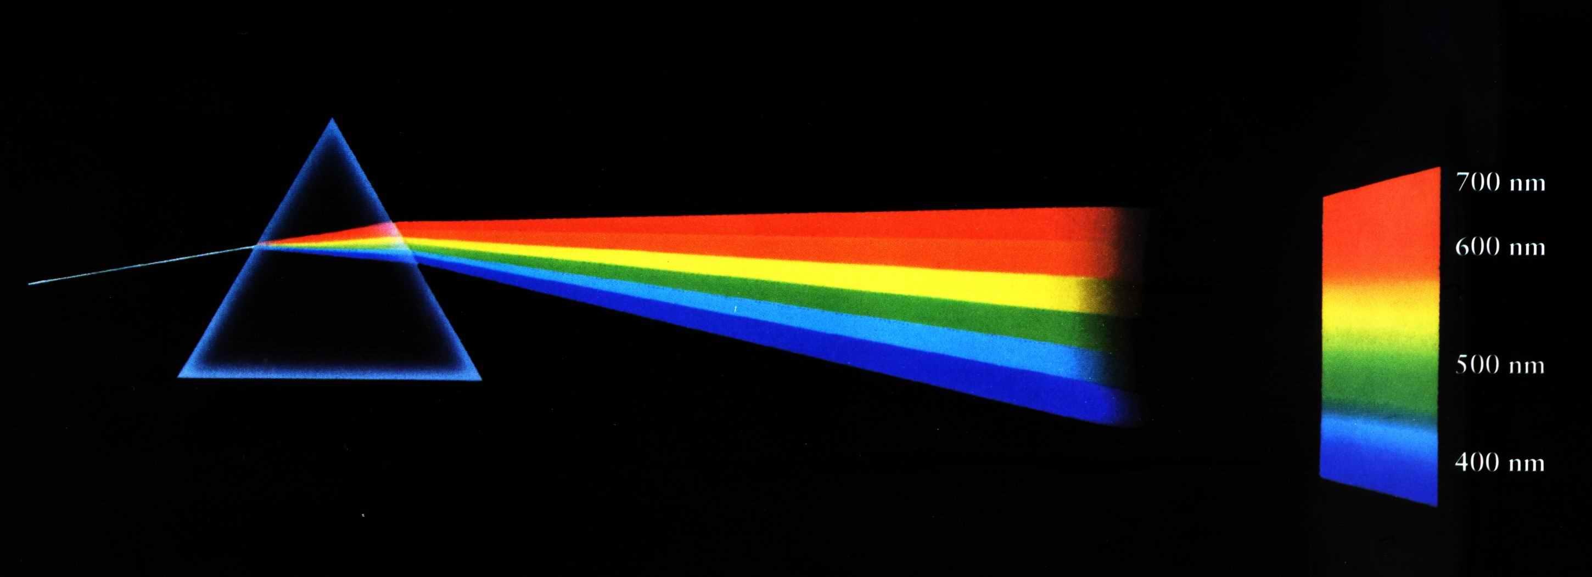
How does a prism show the light spectrum?
Light enters the prism and the glass separates “colors” of light within the sunlight so they can be seen individually

Slide 6
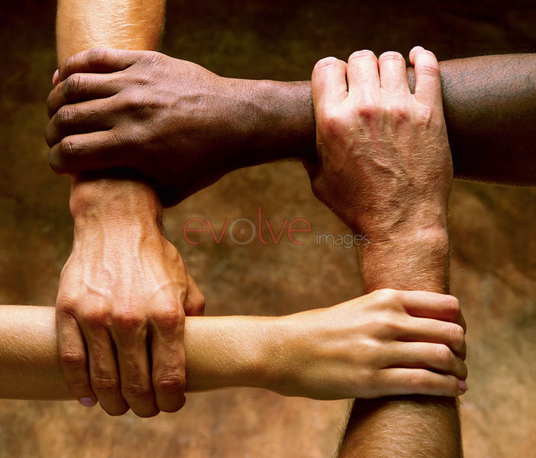
What is a pigment?
A chemical that absorbs certain colors of light
Example: melanin

Slide 7
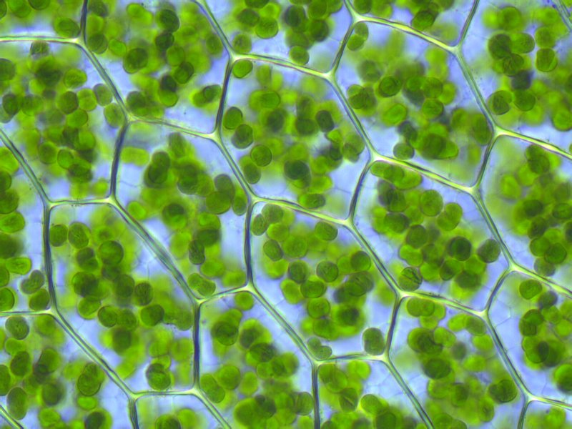
Why is chlorophyll important to a producer?
Chlorophyll is a green pigment that is used by producers to absorb sunlight
This sunlight absorbed by chloroplasts in plant cells is eventually converted to “food energy” or glucose sugar through photosynthesis

Slide 8
Dinosaurs!
Without photosynthesis, there is no food
One theory about the extinction of the dinosaurs is that all plants were killed by fire and other effects of the asteroid collision with earth
Since all plants died, dinosaurs that ate those plants (primary consumers/herbivores) died
Since the food web depends on the levels below to support the levels above, all dinosaurs eventually died

