Slide 1
Symbiosis Notes

Slide 2
Warm Up
Describe three BENEFICIAL relationships that are a part of your life
Ex. I have a relationship with Mr. Tran, my teacher. He helps me to understand and learn new things
Then imagine placing a:
(+) sign next to the individuals that benefit from the relationship
(-) sign next to the individuals that are harmed by the relationship
(0) next to individuals who are unaffected (neither benefit nor harmed) by the relationship

Slide 3
Relationships in Ecosystems
There are many ways that organisms interact with each other within ecosystems
We have previously studied food webs as a way to map the flow of energy through an ecosystem from the sun to top consumers and back to producers again
There are more complex relationships that we will explore next

Slide 4
Symbiosis
Symbiosis describes any long-term relationship between two organisms from different species
These relationships always benefit one organism
The other organism may
1) benefit as well
2) be harmed by the relationship
3) neither benefit nor be harmed by the relationship.

Slide 5
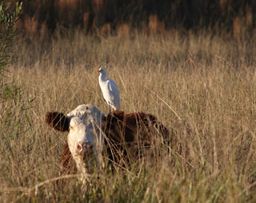
Mutualism
Mutualism describes a type of long-term relationship between two organisms in which BOTH organisms benefit
Example:
Clownfish and sea anemones
Who benefits? Who is harmed?
Bird eating ticks off of cow
Who benefits? Who is harmed?

Slide 6
Commensalism
Commensalism describes a type of long-term relationship between two organisms in which one organism benefits, and the other is unaffected
Example:
Remora hitching a ride on a shark
Who benefits? Who is harmed?

Slide 7
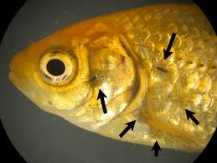
Parasitism
Parasitism describes a type of long-term relationship between two organisms in which one organism benefits, and the other is harmed
Example:
Parasitic fish “lice”
Who benefits? Who is harmed?

Slide 8
Homework
Find 2 new examples of each type of symbiosis discussed in class today (mutualism, parasitism, and commensalism)
Be sure to describe whether each organism benefits from, is harmed by, or is unaffected by the relationship and why
You may use the links provided in the resources and multimedia section of the class page to begin your research

