Slide 1
Unicellular vs. Multicellular
Which is better?

Slide 2
Questions to Consider
How quickly can it reproduce?
How specialized can it be?
How large can it grow?
How long does it take to develop?
How long can it live?
How quickly can it adapt and evolve?
How easy is it to find a mate?
How much food/nutrition does it need?
What type of environments can it live in?
How diverse can the species be?

Slide 3
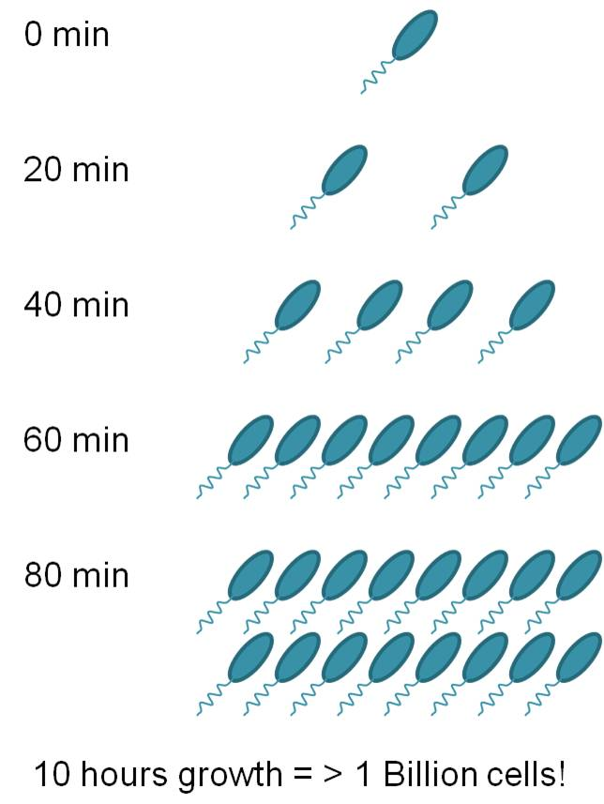
How quickly can it reproduce?
A single (unicellular) bacteria can multiply into over 2 million in one school day!

Slide 4
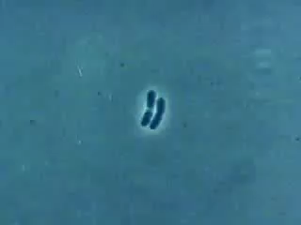

Slide 5
How specialized can it be?
Multicellular organisms can perform many specialized functions (think of all the things you can do!) whereas bacteria and other unicellular organisms live very simple lives

Slide 6
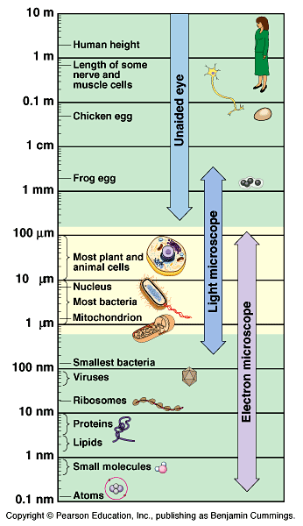
How large can it grow?
Multicellular organisms grow much larger than unicellular organisms. You need a microscope to see most unicellular organisms!

Slide 7
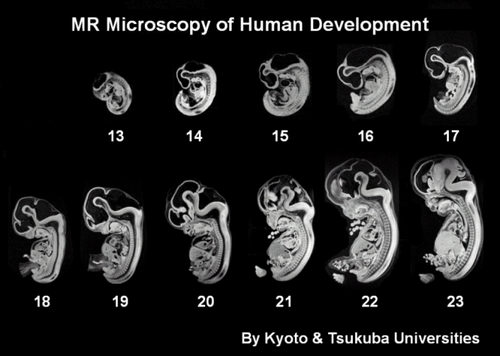
How long does it take to develop?
Unicellular organisms develop from brand new cells to full maturity extremely rapidly. This allows them to reproduce at extreme rates!

Slide 8
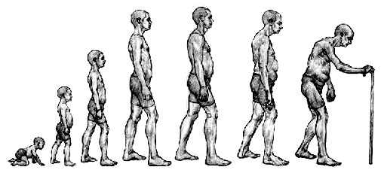
How long can it live?
Because unicellular organisms grow and develop quickly, they also live shorter lives. Few bacteria live for the lifespan a human being would (without “inactive” states)

Slide 9
How quickly can it adapt and evolve?
Review:
adaptations are inherited (through DNA) characteristics
over many generations, if those characteristics are favorable, the entire species will evolve to express those adaptations.
Since bacteria can reproduce quickly, they cycle through generations quickly, and thus evolve more quickly than multicellular organisms
MRSA = methicillin-resistant staphylococcus aureus

Slide 10
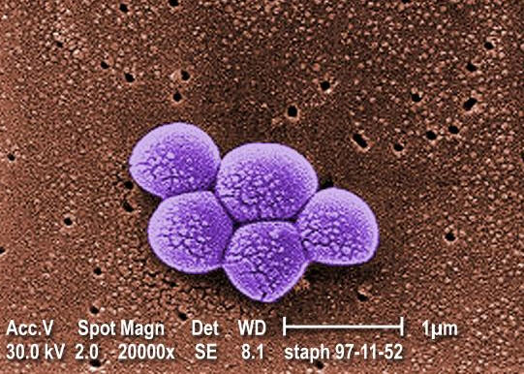
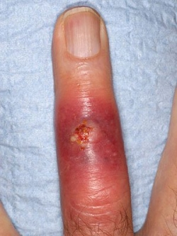
MRSA

Slide 11
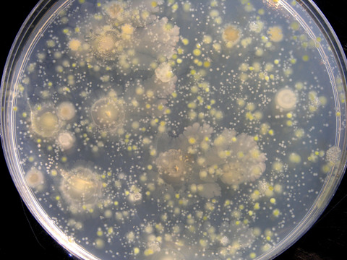
How easy is it to find a mate?
Many unicellular organisms like bacteria reproduce asexually, so they do not have to find a mate at all! Even sexually reproducing unicellular organisms would tend to live together and in high densities, therefore making finding a mate easy.

Slide 12
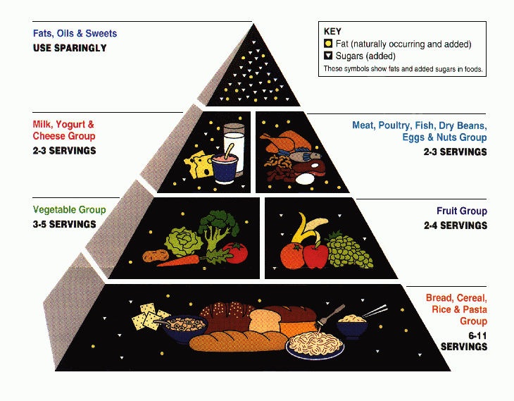
How much food/nutrition does it need?
Unicellular organisms require much less food because they are efficient. Think motorcycle vs. 18 wheeler

Slide 13
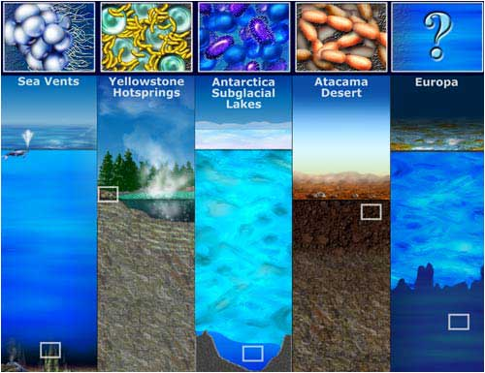
What type of environments can they be found in?
Multicellular organisms require very specific conditions for life, but unicellular organisms tend to be able to live in the most extreme places on earth!

Slide 14
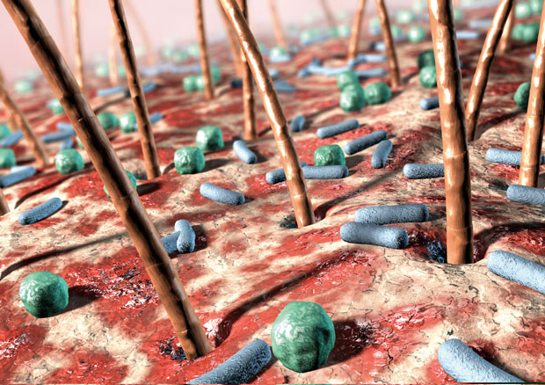
How diverse can the species be?
500 to 1000 species of bacteria live on your skin!
Unicellular organisms are extremely diverse, and constantly adapting, evolving, and creating entirely new species!

Slide 15
Questions to Consider
How quickly can it reproduce? Unicellular faster
How specialized can it be? Multicellular more specialized
How large can it grow? Multicellular grows larger
How long does it take to develop? Unicellular develops faster
How long can it live? Multicellular live longer
How quickly can it adapt and evolve? Unicellular evolve faster
How easy is it to find a mate? Unicellular find mates easier
How much food/nutrition does it need? Unicellular need less food
What type of environments can it live in? Unicellular can live in more extreme environments
How diverse can the species be? Unicellular are more diverse
Depending on how you look at it, both unicellular and multicellular organisms can have advantages!

