Slide 1
Unicellular vs. Multicellular Organisms
Creating a T Chart of Benefits and Limitations

Slide 2
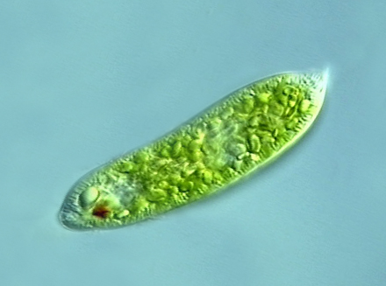
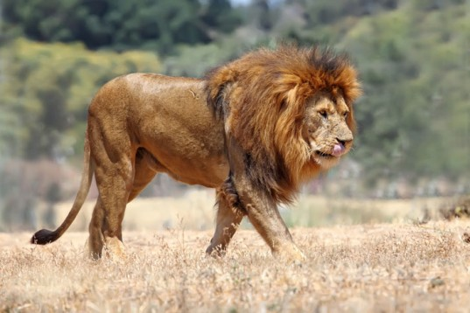
Structure
Unicellular Organism
Multicellular Organism
Body is made up of a single cell
Body is made up of numerous cells

Slide 3
Division of Labor
Unicellular Organism
Multicellular Organism
Division of labor is at the organelle level. It gives a low level of operational efficiency
Division of labor may be at cellular, tissue, organ and organ system level. It gives a high degree of operational efficiency

Slide 4
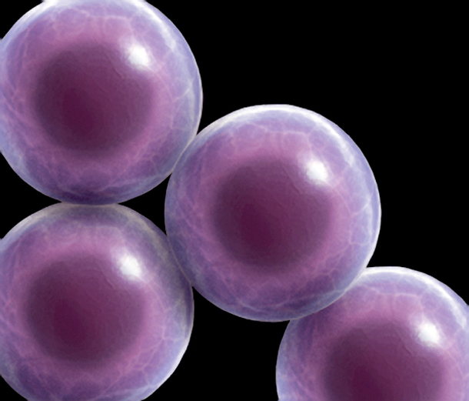
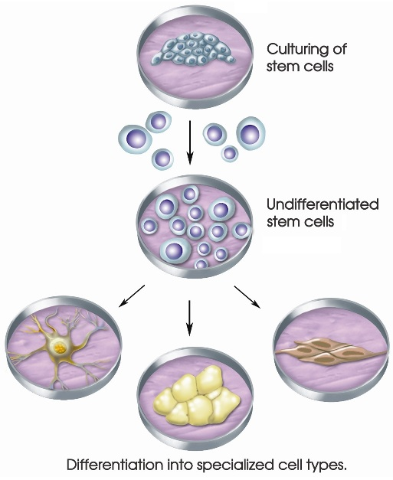
Specialization
Unicellular Organism
Multicellular Organism
A single cell carries out all the life processes
Different cells are specialized to perform different functions

Slide 5
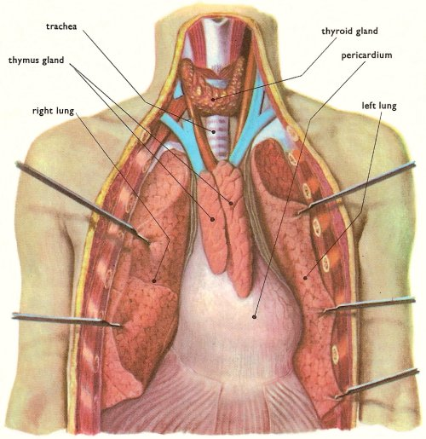
Exposure to Environment
Unicellular Organism
Multicellular Organism
The cell body is exposed to the external environment on all sides
Only outer cells are specialized to face the environment. Inner cells are devoted to other functions

Slide 6
Injury
Unicellular Organism
Multicellular Organism
An injury of the cells can cause death of the organism
Injury or death of some cells does not affect the organisms as the same can be replaced by new one

Slide 7
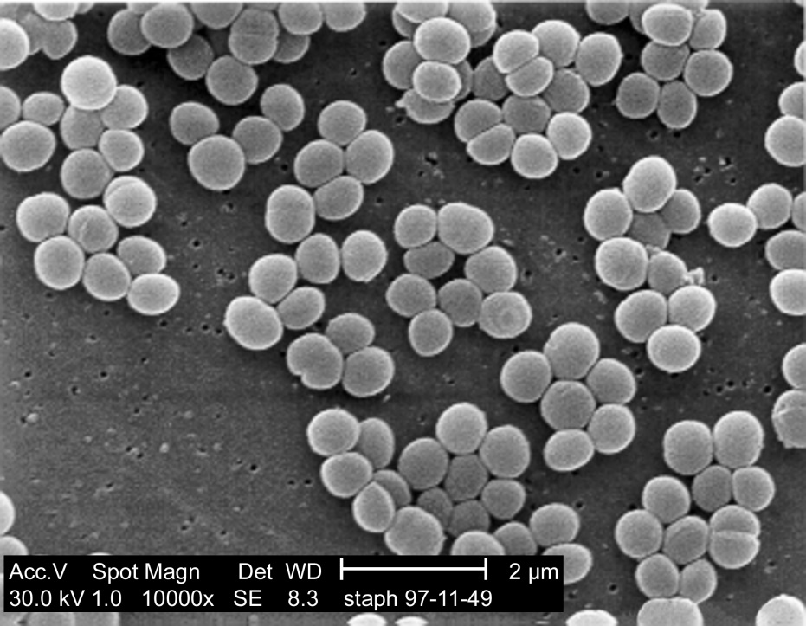
Size Limitation
Unicellular Organism
Multicellular Organism
A cell body cannot attain a large size because of the limit imposed by surface area to volume ratio
A multicellular body can attain a large size by increasing the number of small cells

Slide 8
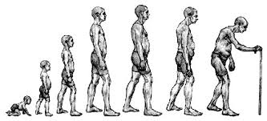
Lifespan
Unicellular Organism
Multicellular Organism
Lifespan is short due to heavy load of work
Lifespan is long due to limited load of work for each cell type

Slide 9
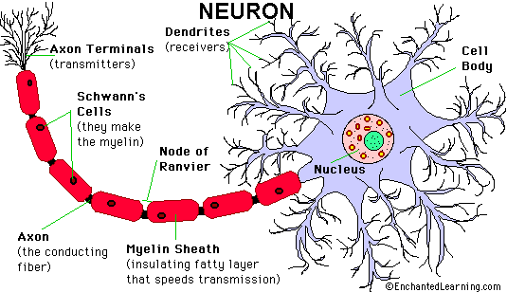
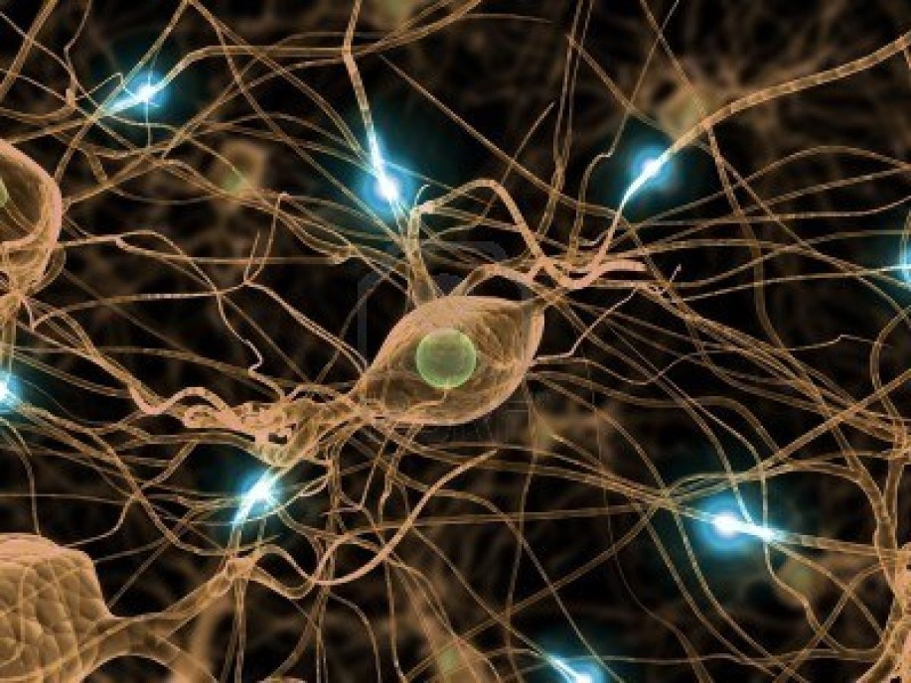
Ability to Divide
Unicellular Organism
Multicellular Organism
Power of division is not lost
Certain specialized cells lose power of division (ex. Nerve cells)

Slide 10
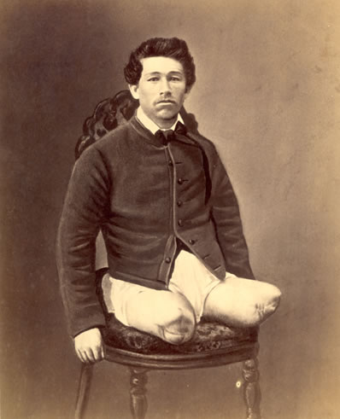
Regeneration
Unicellular Organism
Multicellular Organism
A well-marked capacity of regeneration is present
The capacity of regeneration decreases with increasing specialization (more special = less easy to regenerate)

Slide 11
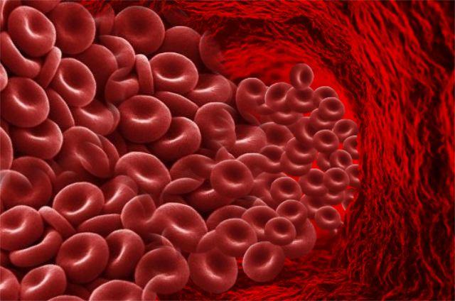
Cell Roles
Unicellular Organism
Multicellular Organism
The cell has the same role for itself and the organism
Cells have a double role. One for themselves and other for the organism

Slide 12
Unicellular organism | Multicellular organism
1. Body is made up of a single cell | Body is made up of numerous cells
2. Division of labor is at the organelle level. It gives a low level of operational efficiency | Division of labor may be at cellular, tissue, organ and organ system level. It gives high degree of operational efficiency
3. A single cell carries out all the life processes | Different cells are specialized to perform different functions
4. The cell body is exposed to the external environment on all sides | Only outer cells are specialized to face the environment. Inner cells are devoted to other functions
5. An injury of the cells can cause death of the organism. | Injury or death of some cells does not affect the organisms as the same can be replaced by new one.
6. A cell body cannot attain a large size because of the limit imposed by surface area to volume ratio | A multicellular body can attain a large size by increasing the number of small cells
7. Lifespan is short due to heavy load of work | Lifespan is long due to limited load of work for each cell type
8. Power of division is not lost | Certain specialized cells lose power of division (ex. Nerve cells)
9. A well-marked capacity of regeneration is present | The capacity of regeneration decreases with increasing specialization (more special = less easy to regenerate)
10. The cell has the same role for itself and the organism | Cells have a double role. One for themselves and other for the organism

