Slide 1
What is cancer?

Slide 2
http://www.youtube.com/watch?v=LEpTTolebqo

Slide 3
What is cancer?
Definition:
Group of over 100 diseases characterized by abnormal uncontrolled cell growth (division)

Slide 4
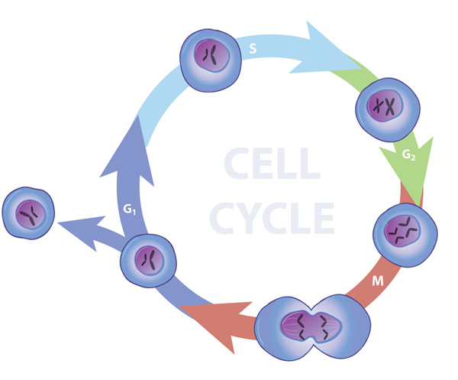
What happens normally?
In a healthy body, cells grow, die, and are replaced in a very controlled way

Slide 5
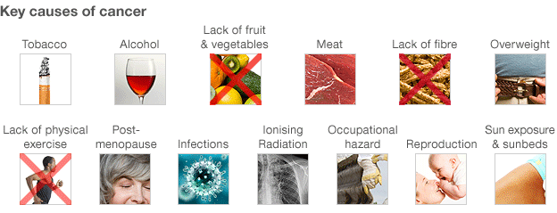
When does the problem arise?
Damage or change in the genetic material of cells by environmental or internal factors sometimes results in cells that do not die and continue to multiply until…

Slide 6
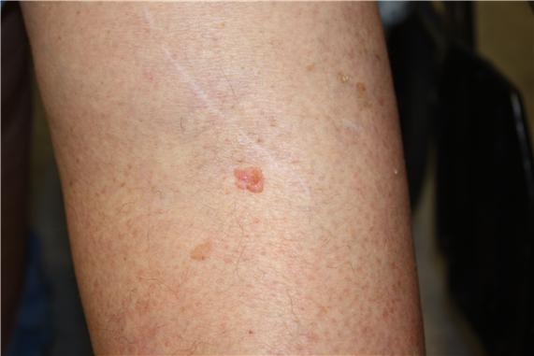
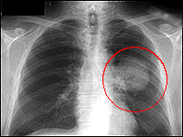
A mass of cancer cells or “tumor” develops

Slide 7
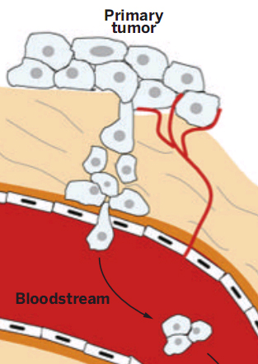
It gets worse…
Metastasis
Spread of cancer cells to other parts of the body
Categorization of cancer
Malignant
Can invade other tissues
Benign
Will not invade other tissues

